Slide 1


Mojaloop deployment experience in Myanmar
PI - 18 OSS Community Meeting
27 April 2022
Thynn Win

Slide 2
Agenda
A brief intro about ThitsaWorks
WynePay journey
What’s next
Suggestions
2

Slide 3

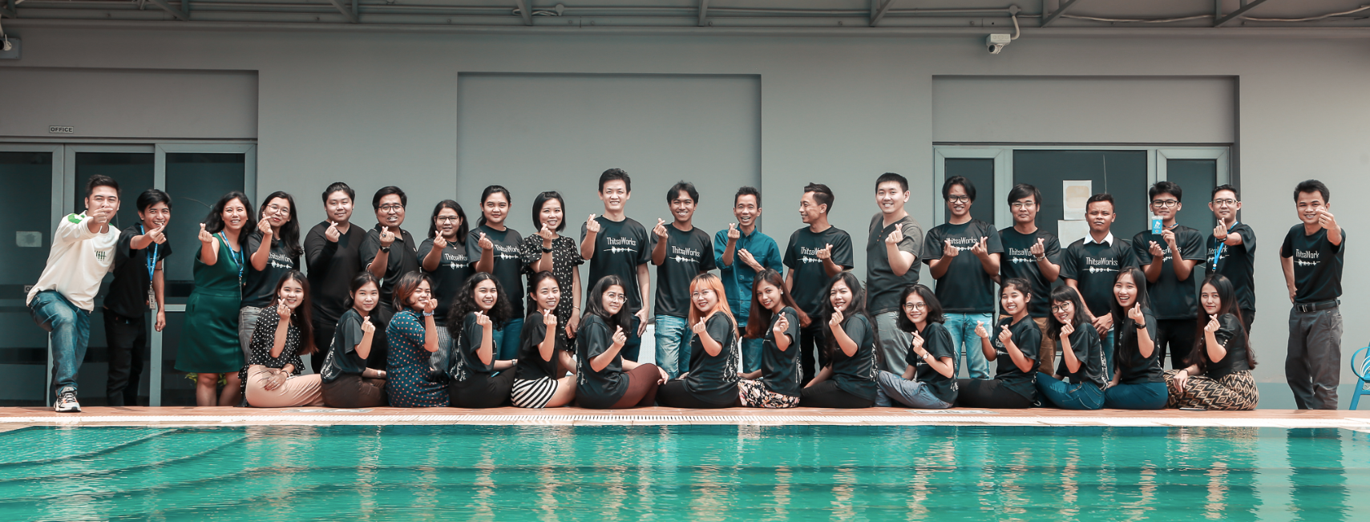
ThitsaWorks
About us
Fin-tech founded in 2016
Based in Myanmar, Singapore (SFA certified)
45+ members
3 international partners (Modusbox, Musoni and Mifos)
Notes:
Thitsaworks is a fintech company founded in Myanmar in 2016. We have expanded to Singapore and is certified by Singapore Fintech Association. There are about 45+ members in different countries . 3 international partners (Modusbox, Musoni and Mifos) are sharing our journey to reaching our mission.

Slide 4

ThitsaWorks
Our Mission
Notes:
Our mission is to power financial inclusion. We would like to be one of the forces that transform the societies where many of them have limited or no access to credits or financial literacy to break the vicious cycle and empower them to rise out of poverty.

Slide 5





Our Solutions
Microfinance Credit Information Exchange
Digital learning platform & Apps
Mitigate risks, analyze credit worthiness
and get alerts with MCIX
provide financial literacy to clients on our digital learning platform and apps
Insight on unbanked population
Insight
Access financial literacy
Access
WynePay
Core banking software & support service
make real-time payments on
WynePay built on Mojaloop platform
Digitize
manage loan portfolio with stellar core
banking system software
and get excellent support service
Digitize back-end processes and payments

Slide 6
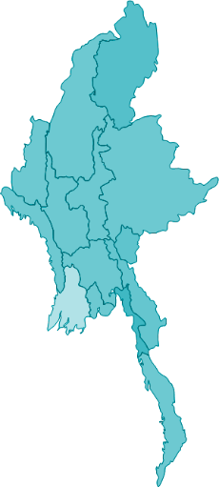
ThitsaWorks
70
Financial Institutions trust ThitsaWorks with their digital transformation
1M
Unbanked received digital financial literacy content
3M
Credit reports of unbanked borrowers analyzed monthly
600K
3 out of 4 unbanked borrowers in Myanmar reported by ThitsaWorks.
1 out of 10 unbanked borrowers in Myanmar managed with core banking software supported by ThtisaWorks.

Slide 7
WynePay Journey
LIVE
Live
Closed User Group
Everyone
Some controlled users
CUG
FUT
Friendly User Testing
Employees of MFIs
7

Slide 8









WynePay Journey
CUG
FP V3’
FUT’
FP V3
FUT
FP V2
Added two more
participants
2021
2022
Apr
May
Jun
Jul
Aug
Sep
Oct
Nov
Dec
Jan
Feb
Mar
Apr
May
Jun
Course
Core Connector in PM4ML
Grafana, Kibana, PM4ML
TTK, RBAC
Oracle, Loki
Infra
8
Notes:
Last year around mid April, we started getting serious with implementation and took Mojaloop courses. It was immensely helpful!
We started building the core connector for Mifos and learned both disbursement and repayment workflow and apis. Over the next few months, we onboarded 3 MFIs. In Aug, we set a FUT go-live date as Sept 30 and onboarded one wallet. To their credit, the wallet made it in a months time and we first launched it with 2 Mfis and one wallet. Unfortunately, we had to shut it down the next day because we had trouble closing the window. Finance portal version 2 had a few other issues such as the need to have key-in the balances from the settlement bank and the NDCs not reflecting the new “low” balances. From Hub perspective, it poses a huge risk of typos and participants transacting more than what they have in the liquidity account.

Slide 9
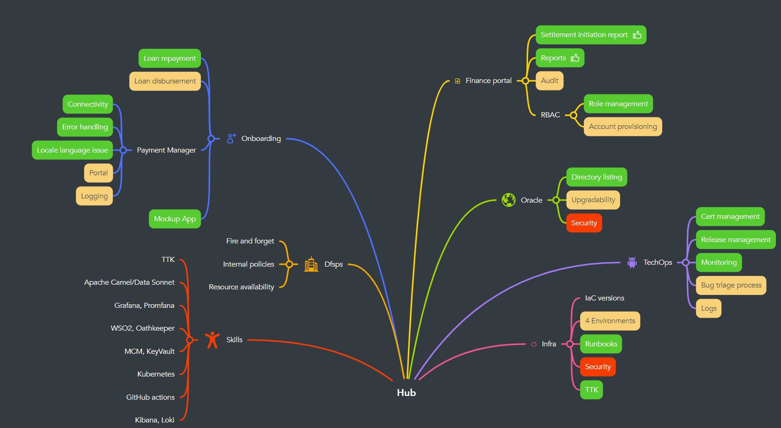
Implementation Journey
9
Notes:
Yellow are work in progress, green means done and red needs improvements.

Slide 10
Next Steps
LIVE
CUG
Closed User Group
CUG
Harden security
Spread the knowledge
Stabilize the infrastructure/toolsets
Additional scenarios:
Bulk Disbursement
Electronic Cash Transfer (ECT)
10

Slide 11
Next Steps
LIVE
Full scale launch
Live
Develop DFSP portal
Implement fee settlement
Integrate with settlement bank
Streamline report generation process
Additional Scenario:
P2P
11

Slide 12
Suggestion
Involve users
Stabilize & drive adoption
Capture realistic requirements by engaging users at the design phase
Focus on making existing infra and features stable
Test for LIVE
Share knowledge
Test comprehensively with all scenarios not just Golden Path (GP) or for POC
Clarify what’s implemented and working vs. GP solutions or roadmap items. Make info such as implementation details available so that different teams can be on the same page and others can help out
12

Slide 13
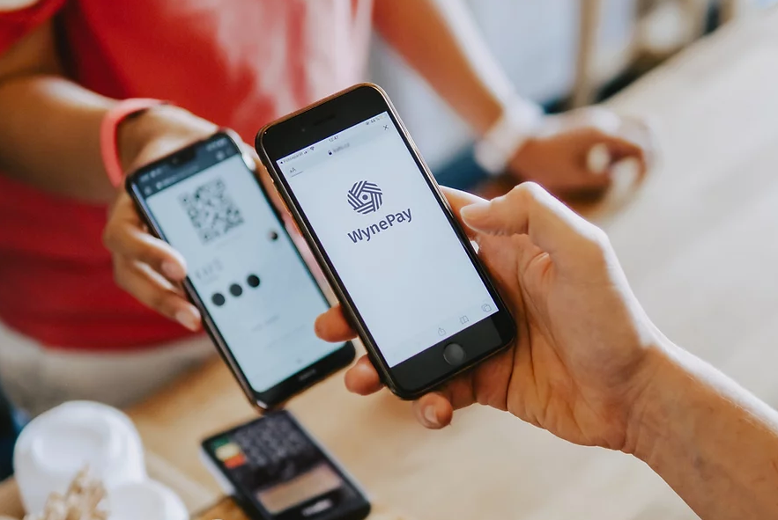
Thank you!
Modusbox team
Jane, Paul Makin, Paul Baker, Michael, Yordan, Juan, Sam, Vijay, Oscar and team, David, and more...
Dfsps
Vision Fund Myanmar
OKDollar
Hana
CB Pay
James Bush
Steve Haley
Miller Abel
13

